Slide 1

Sprocket Central Pty Ltd
Data analytics approach
Tanmay Phalke

Slide 2
Agenda
Introduction
Data Exploration
Analysis
Interpretation

Slide 3
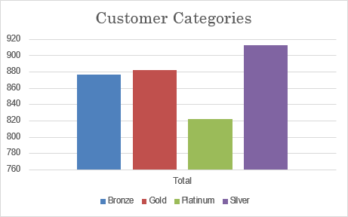
Introduction
Customer Categories: it enables us to classify our customers and come up with specific strategies for each category.
We have given 4 categories to our customers: Bronze, SIlver, Gold, Platinium
-We notice that most of the customers are under Silver category: 910 and least of them in the Platinum category.
-By converting these categories to their higher level or by targeting ads to specific categories we can increase the retention rate of these customers.

Slide 4
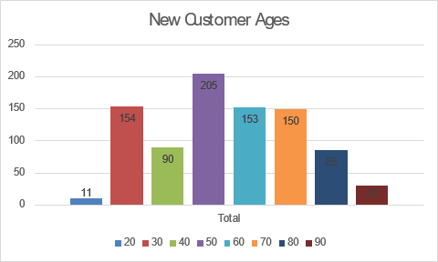
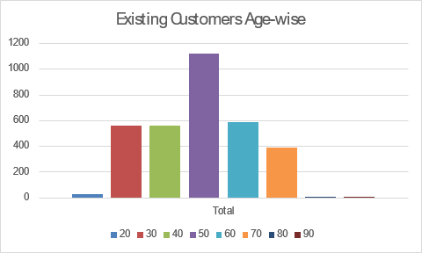
Data Exploration
Customers- Age Analysis.
-Most of our customers fall under 40-60 category.
-In the age group around 20, 80+ we have lowest number of customers.
-Most of the other age categories follow similar trend except the category 70,80 where there seems to be a rise in the new customers.

Slide 5
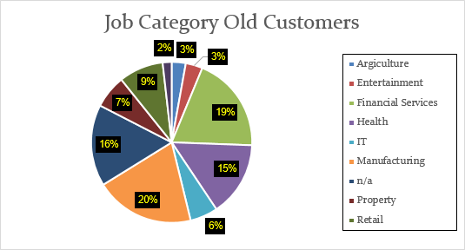
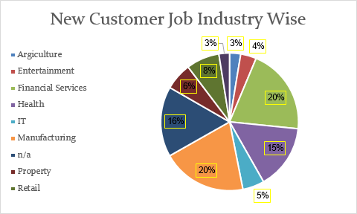
Data Exploration
Customers- Jobs Analysis.
Manufacturing accounts to 20% of the population distribution which remains the same for the new as well.
The overall distribution for all the job categories remains the same with very less change.

Slide 6
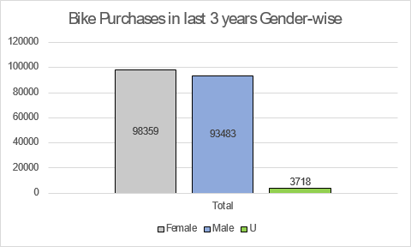
Data Exploration
Gender Analysis of Customers
The females have most of the purchases related to bikes in the past 3 years.
The female account for 5000 more purchases than males and Undefined categories.

Slide 7
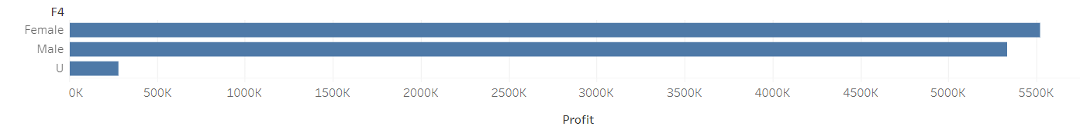
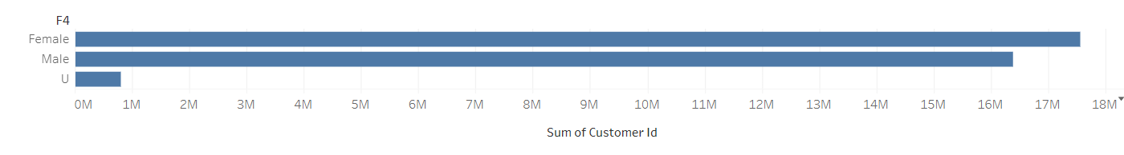
Data Exploration
Gender Analysis of Customers
Customer vs Gender Comparison
Customer vs Profit Comparison

Slide 8
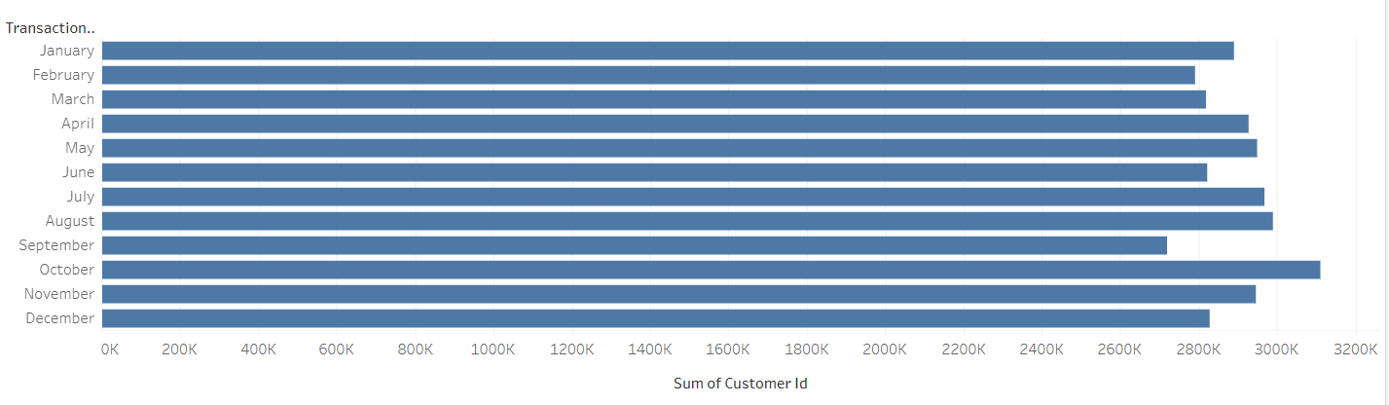
Data Exploration
Month-wise Analysis

Slide 9
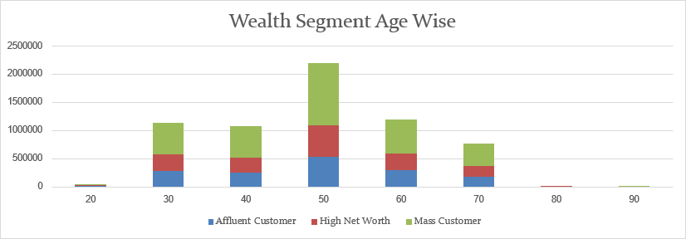
Wealth Segmentation Analysis
-Most of the customers fall under Mass Customer categories which remains dominant across all age groups.
-For the age of 80 we mostly have High Net Worth Clients only
-For the remaining age groups these follow 2:1:1 ratio.

Slide 10
Model Development
Draw out a hypothesis related to the business question that can be answered with this data.
Use the statistical analysis to determine if the hypothesis holds true or not.
Form various calculated fields that will help in generating more insights about the data. E.g. Age categories, age from D.O.B.
Test the performance of the model with various tests and draw conclusions about the performance, assumptions and its limitations.

Slide 11
Interpretation
Interpretation allows us to visualize our data and access it and interact with it to make business decisions.
By using the Software such as Excel, Tableau, PowerBi we can create a dashboard that will allow us to interact with the data in real time.
We can find out qualitative, and quantitative observations about the business issue and draw conclusions and solutions to solve them.

